Slide 1
Higher Order Thinking Questions
Write down 5 observations you can think of about solids liquids and gases

Slide 2
Solids are usually the heaviest
Solids are denser
Liquids are able to flow
Liquids are a fixed size
Gases are able to flow
Gases are usually colourless and invisible

Slide 3
Particle theory

Slide 4
Learning Intentions
the Particle Model
Successful Learning Criteria
SWBAT Explain the Assumptions of The Particle Model
SWBAT explain the effect heat has on particles

Slide 5
Scientists’ understanding of matter has developed over thousands of years
Science involves developing hypotheses, testing them with reproducible experiments and modifying ideas.
When an idea becomes supported by all the current evidence, then it becomes a theory.
The particle theory of matter has been tested and refined by scientists for more than 2000 years.

Slide 6
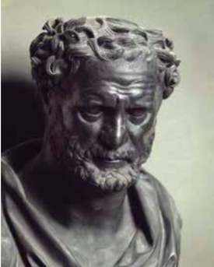
Democritus
Over 2400 years ago, Democritus, a Greek philosopher, put forward the idea that all matter is made up of particles.
He proposed that if you were to cut up these particles into smaller and smaller pieces, you would eventually have tiny particles that could not be cut up any more.
Democritus called these particles atomos, which is Greek for ‘indivisible’. is is the origin of the word atom.

Slide 7
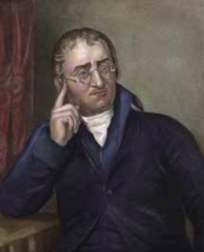
John Dalton
It was not until more than 2000 years later, in the early 1800s, that the Englishman John Dalton developed Democritus’s idea further.
Dalton’s ideas were based on the results of experiments performed by many earlier chemists.
Dalton studied these results and proposed a model to explain them.
His model was that matter is made of particles.

Slide 8
Dalton’s ideas
All matter consists of tiny particles called atoms.
Atoms cannot be created or destroyed, and are indivisible.
All atoms of the same element are identical, but different from atoms of other elements.
When atoms combine to form compounds, each atom keeps its identity.

Slide 9
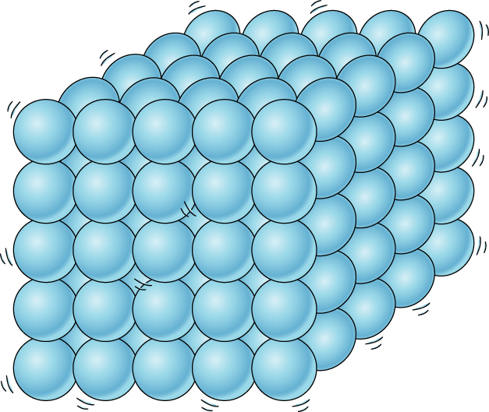
Matter
All matter is made up of tiny particles
The arrangement of these particles give each state of matter their properties.
We call this the particle theory model

Slide 10

Notes:
5.09 mins

Slide 11
The Particle Model makes three assumptions
Solids, liquids and gases are all made up of hard, ball-like particles that cannot be split.
These particles are constantly moving and jiggling
There are forces holding these particles together

Slide 12
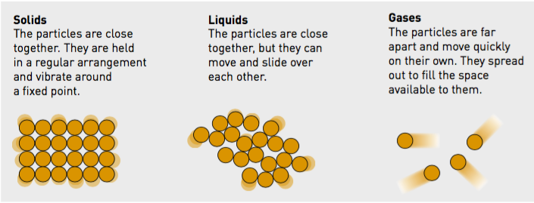
Particle theory

Slide 13
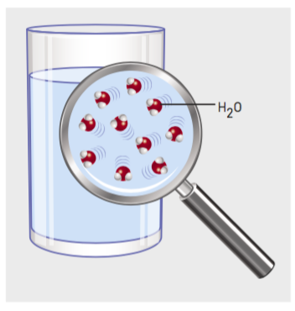
Modern chemistry
This new understanding encouraged scientists to find out more and more about these tiny particles, eventually leading to the branch of science now called chemistry.
A glass of water is made up of molecules. each molecule contains two hydrogen atoms and one oxygen atom.

Slide 14
We can add some new ideas to Dalton’s list to help us explain matter.
Particles are too small to be seen.
Particles are always moving.
When it is hotter, the particles move faster
When it is cooler, the particles move slower.
Particles have mass.
Particles can join to make larger particles.
When they combine, their masses add together.
There are spaces between particles.
Forces hold particles together to stop them from separating.
Notes:
All these ideas or rules explain how particles act in real substances. e real particles follow these rules in all substances.

Slide 15
Video
https://ed.ted.com/lessons/the-2-400-year-search-for-the-atom-theresa-doud

Slide 16
Quiz
https://ed.ted.com/lessons/the-2-400-year-search-for-the-atom-theresa-doud#review

Slide 17
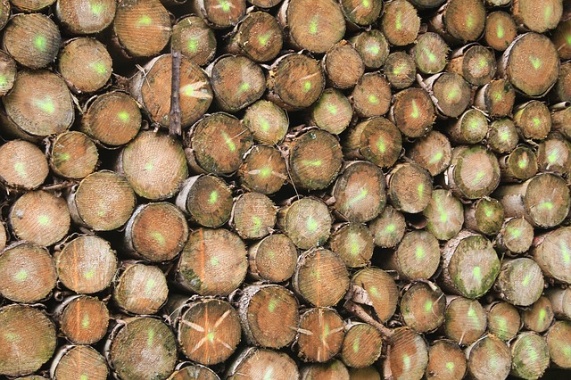
Wood

Slide 18
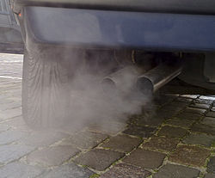
Exhaust fumes from a car

Slide 19
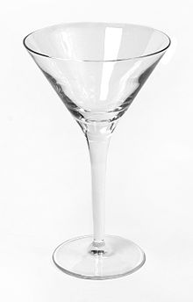
Glass

Slide 20
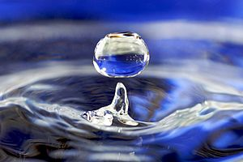
Water

Slide 21
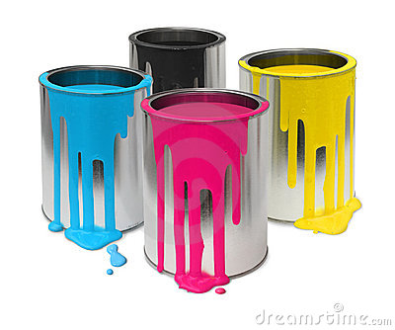
Paint

Slide 22
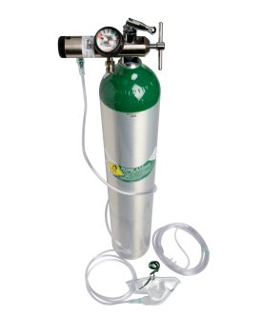
Oxygen from a cylinder

Slide 23
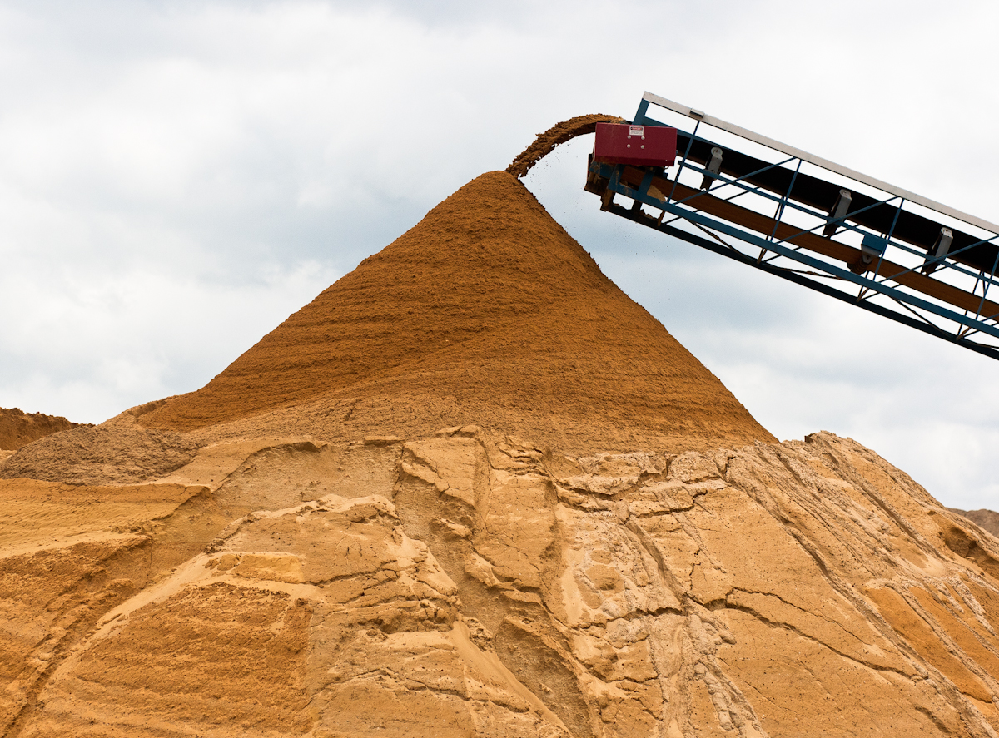
Sand

Slide 24
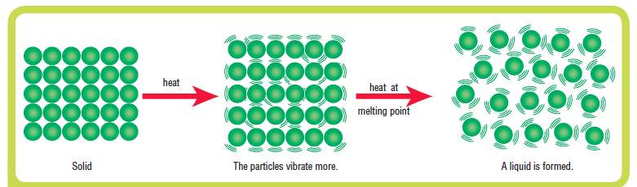
The effect of heat on particles
As particles in a solid gain heat energy, they vibrate faster.
It is then possible for them to break out of their fixed positions and move past each other as the substance becomes a liquid
This is called melting
As the energy is supplied and absorbed by the liquid, particles gain enough energy to leave the liquid as a gas vapour.
This is called evaporation
Notes:
Draw this diagram

Slide 25
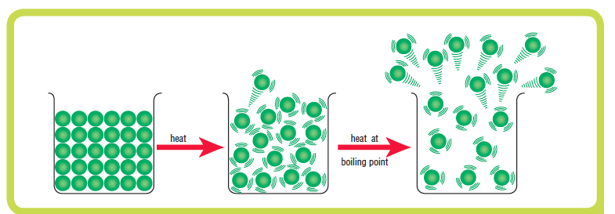
The effect of heat on particles
As the liquid particles gain heat energy, more and more particles have enough energy to evaporate at the surface
At the boiling point, all the particles have enough energy to evaporate and boiling occurs.

Slide 26
Changing States-The Particles
Explain in terms of the energy of particles
why:
Solids melt
Liquids evaporate
Gases condense
Liquids freeze
Extension: Give an example of each.
Remember! When particles gain energy they start to vibrate more and more and more until....?
10 minutes
Notes:
45min & answers – 50min

Slide 27
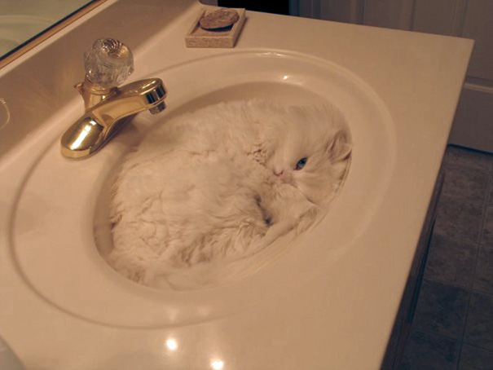
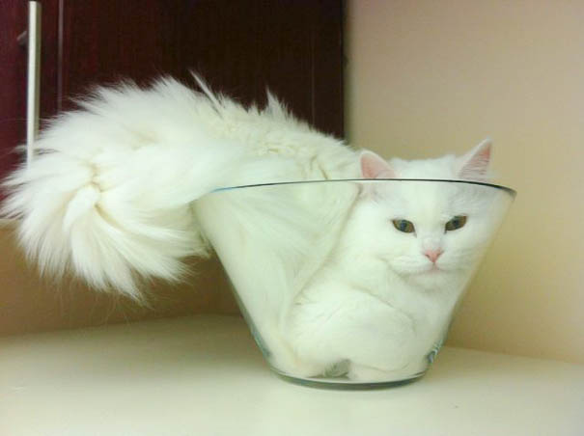
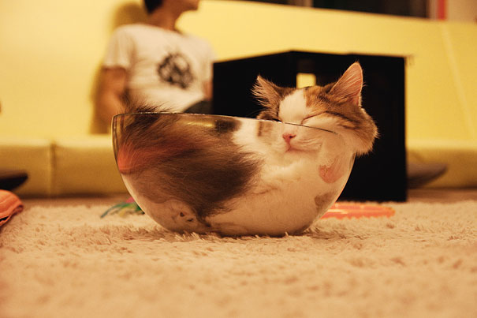
Liquids take the shape of containers and maintain almost-fixed volume.
Proof cats are liquid

Slide 28
Learning Intentions
the Particle Model
Successful Learning Criteria
SWBAT Explain the Assumptions of The Particle Model
SWBAT explain the effect heat has on particles

